Slide 1
EVAT Capstone Project: Use Case: Reliability Scoring and Dashboard Insights
Presented by
- Dheepak SK

Slide 2
Project Overview
About EVAT Project:
EVAT (Electric Vehicle Adoption Tools) is a capstone initiative aimed at improving EV infrastructure adoption in Victoria.
Focused on providing tools for:
Cost comparison
Charger reliability scoring
User feedback insights
Predictive analytics
Our team has split use cases – I led the Reliability Scoring component.

Slide 3
Reliability Scoring
Use Case: EV Charger Reliability Scoring:
Aim: Evaluate EV chargers across Melbourne based on uptime/downtime, user ratings, and feedback.
Dataset contains:
📍 263 unique station IDs
📌Suburbs like Docklands, Carlton, Dandenong, etc.
⚡Attributes: status, reliability, power, uptime %, user feedback
Developed a weighted scoring system that combines:
Technical metrics (uptime %, downtime %)
Sentiment from real user comments (NLP)

Slide 4
Dataset Summary and Coverage
:
Collected data includes
Charger Name, Suburb, Address
Status (Operational / Faulty)
Uptime %, Downtime % for each stations
User Feedback, Ratings for each station stations
GPS coordinates for mapping
Cleaned and enriched dataset with over 25+ columns

Slide 5
Key Components of Reliability Scoring
Uptime %
Operational availability of the charger over time
Downtime %
Despite being red, Mars is a cold planet
User Feedback
Textual comments, reviews, and numeric ratings
Sentiment Analysis
Using NLP (VADER) to quantify textual tone

Slide 6
Interactive Dashboard
EVAT Dashboard Overview:
Built using Streamlit, hosted on localhost
Features:
Folium-based charger location map
Uptime vs Downtime scatter plot
Reliability histogram
User feedback table
Suburb-level filtering
Real-time dropdowns and animated graphs

Slide 7
EV Charger Reliability Dashboard
Dashboard
Developed an interactive Streamlit dashboard hosted locally
Main Features
Charts:
Uptime vs Downtime analysis
Reliability score distribution
Sentiment breakdown (positive, negative, neutral)
Folium Map: Plot of charger locations with popup info cards
Efficiency
Filters: Suburb-wise filtering of charger stats
Feedback Viewer: See what real users say about each station
Sentiment analysis used to rank chargers based on positive/negative reviews

Slide 8
Key Outcomes & Insights
Positive Feedback helps users discover top-performing chargers
Low-Reliability Chargers identified for future maintenance focus
Low-Reliability Chargers identified for future maintenance focus
Real-time filterable dashboards improve decision-making for users and providers

Slide 9
EVAT Dashboard Overview
Sentiment Analysis on User Feedback:
Used NLTK's VADER to analyze polarity of comments
Categorized reviews as:
Positive
Neutral
Negative
Added Sentiment_Label to dataframe
Pie chart and detailed charger table by sentiment
Helped identify best-performing chargers based on user experience

Slide 10
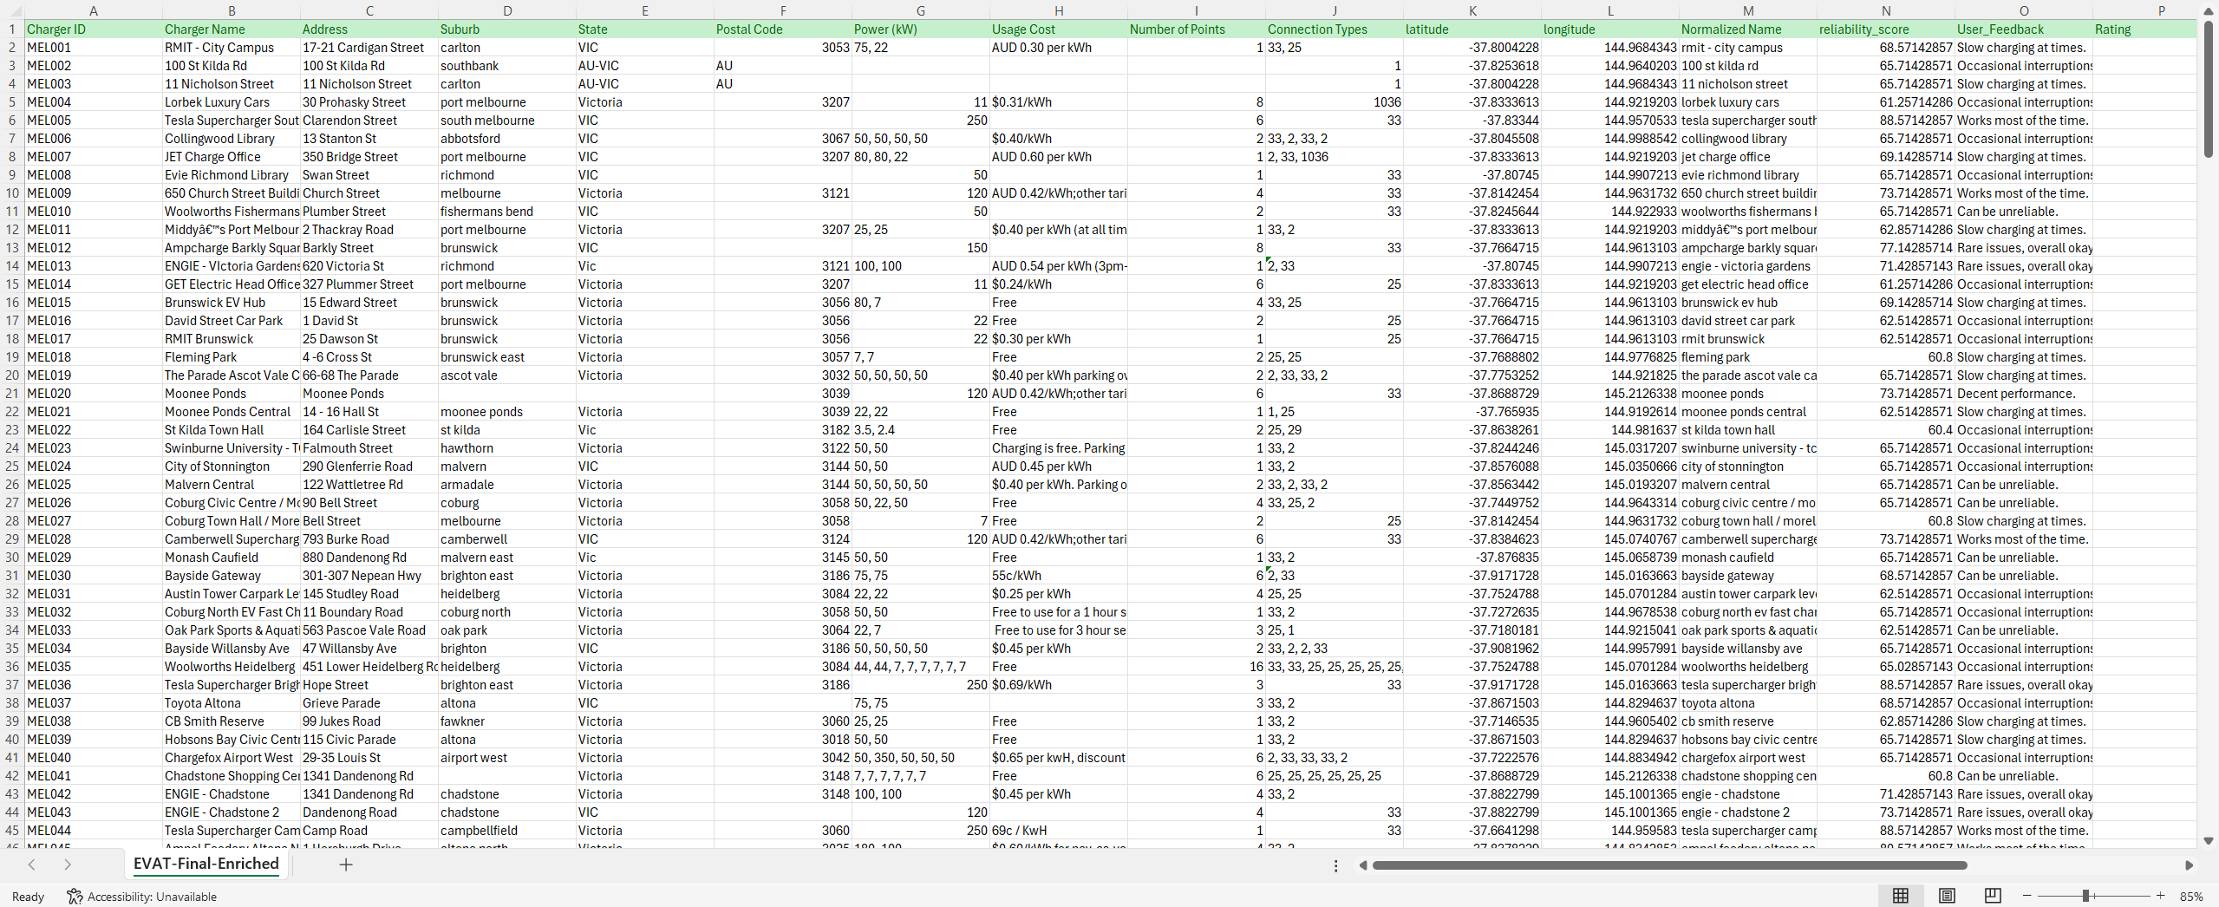
Final Dataset
Dataset - EVAT_Final_Enriched

Slide 11
Benefits of Our Approach
Why Reliability Scoring Matters:
Helps EV drivers find trustworthy chargers
Enables data-driven infrastructure planning
Aids governments and councils in identifying underperforming stations
Makes charger health and feedback transparent and visible
Aligns with sustainability and green energy goals

Slide 12
Thank You
Let’s Accelerate EV Adoption Together 🚗
Questions? Feedback? Let’s chat!
GitHub: [link] Team: Chameleon EVAT – Reliability Scoring

